Slide 1
Didgeridata MIT STEAM Camp
2019

Slide 2
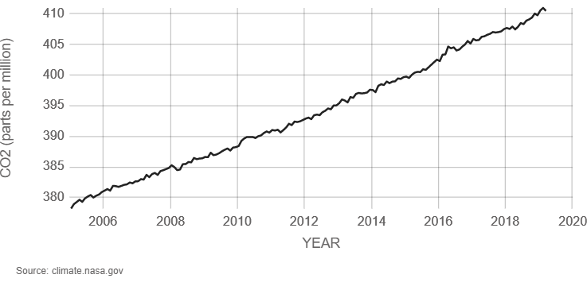
According to NASA …
Airborne CO2 levels are at their highest in 650,000 years
Since 2001, Earth has experienced 18 of the 19 warmest years on record
Polar ice sheets are losing mass
Global average sea level has risen about 128mm over the last 100 years
https://climate.nasa.gov/
Didgeridata | MIT STEAM Camp | 2019

Slide 3
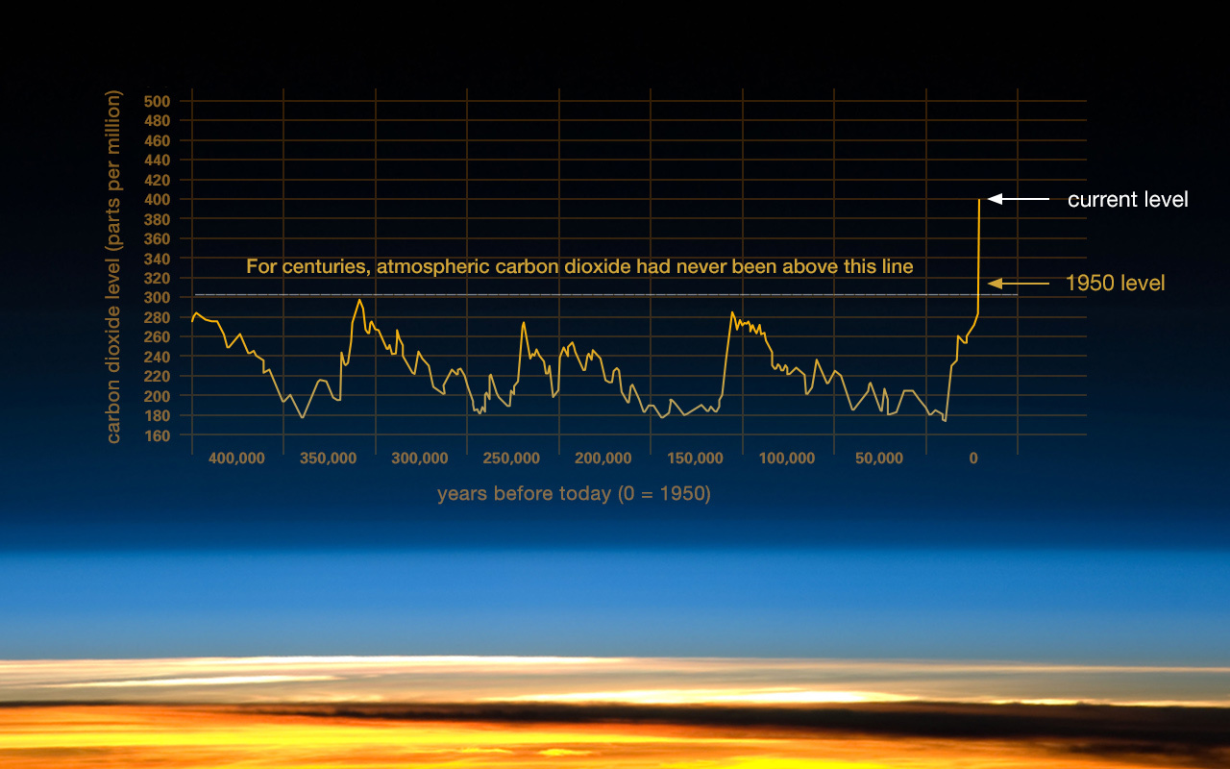
We can see trends in the long-term data
This graph, based on the comparison of atmospheric samples contained in ice cores and more recent direct measurements, provides evidence that atmospheric CO₂ has increased since the Industrial Revolution. (Credit: Vostok ice core data/J.R. Petit et al.; NOAA Mauna Loa CO2 record.)
https://climate.nasa.gov/
Didgeridata | MIT STEAM Camp | 2019

Slide 4
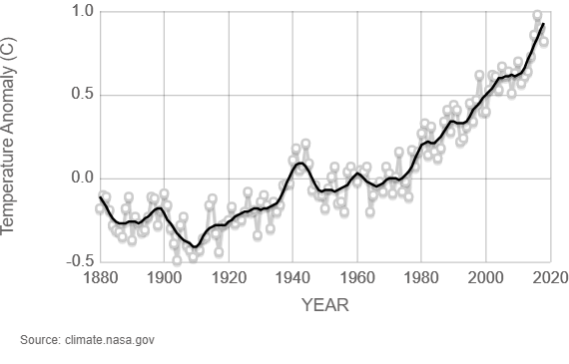
Major disruption is occurring globally in several key areas
Global temperature
Ocean temperature
Ice sheet area
Glacier area
Snow Cover
Sea Level
Arctic Sea Ice
Extreme Weather Events
Ocean pH
Global Temperature Anomalies; 1880-2018
Credit: NASA/GISS
https://climate.nasa.gov/
Didgeridata | MIT STEAM Camp | 2019

Slide 5
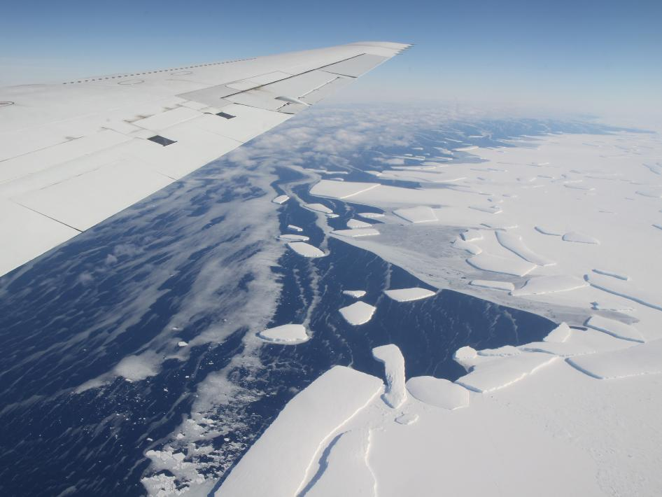
Major disruption is occurring globally in several key areas
Global temperature
Ocean temperature
Ice sheet area
Glacier area
Snow Cover
Sea Level
Arctic Sea Ice
Extreme Weather Events
Ocean pH
Calving front of an ice shelf in West Antarctica. Warming oceans are thought to be connected to
the shedding of icebergs from ice sheets, the floating extensions of glaciers.
Credit: NASA/GSFC/Jefferson Beck
https://climate.nasa.gov/
Didgeridata | MIT STEAM Camp | 2019

Slide 6
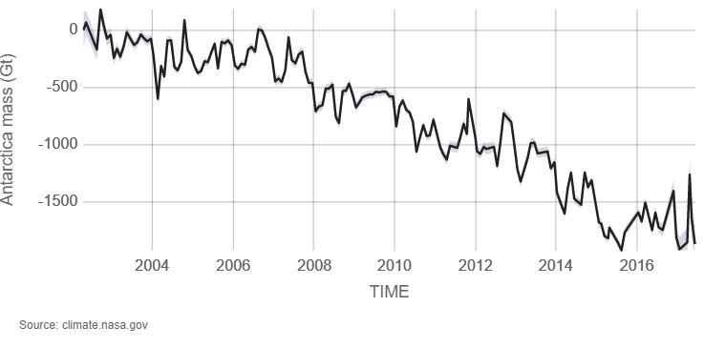
Major disruption is occurring globally in several key areas
Global temperature
Ocean temperature
Ice sheet area
Glacier area
Snow Cover
Sea Level
Arctic Sea Ice
Extreme Weather Events
Antarctica Mass Variation since 2002
Data source: Ice mass measurement by NASA's GRACE satellites. Credit: NASA
Ocean pH
https://climate.nasa.gov/
Didgeridata | MIT STEAM Camp | 2019

Slide 7
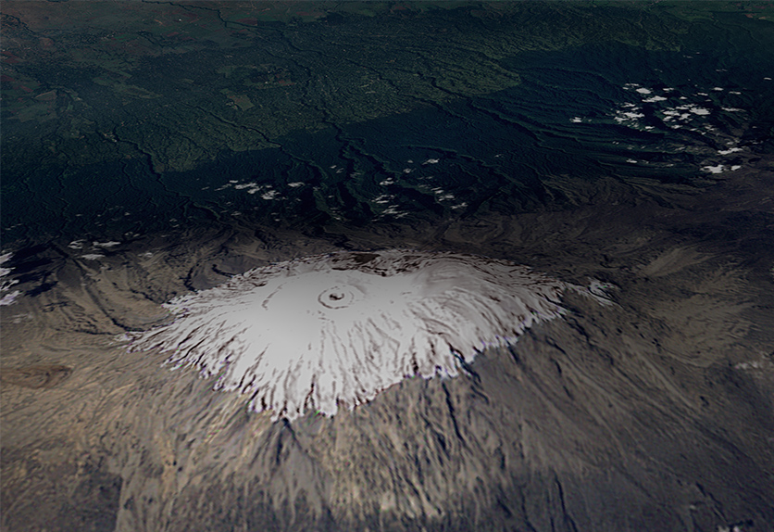
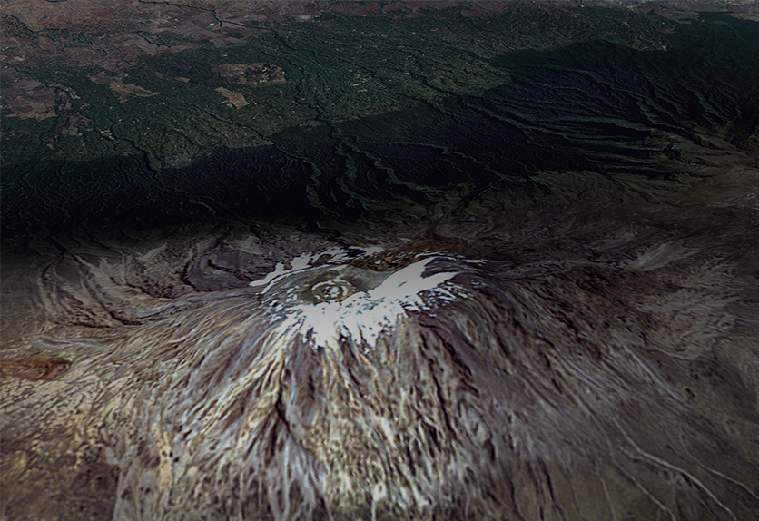
Major disruption is occurring globally in several key areas
Global temperature
1993
2000
Ocean temperature
Ice sheet area
Glacier area
Snow Cover
Sea Level
Kilimanjaro Glacier Retreating, 1993 & 2000 Credit: NASA, LANDSAT Satellite Mission
Arctic Sea Ice
Extreme Weather Events
Ocean pH
https://climate.nasa.gov/
Didgeridata | MIT STEAM Camp | 2019

Slide 8
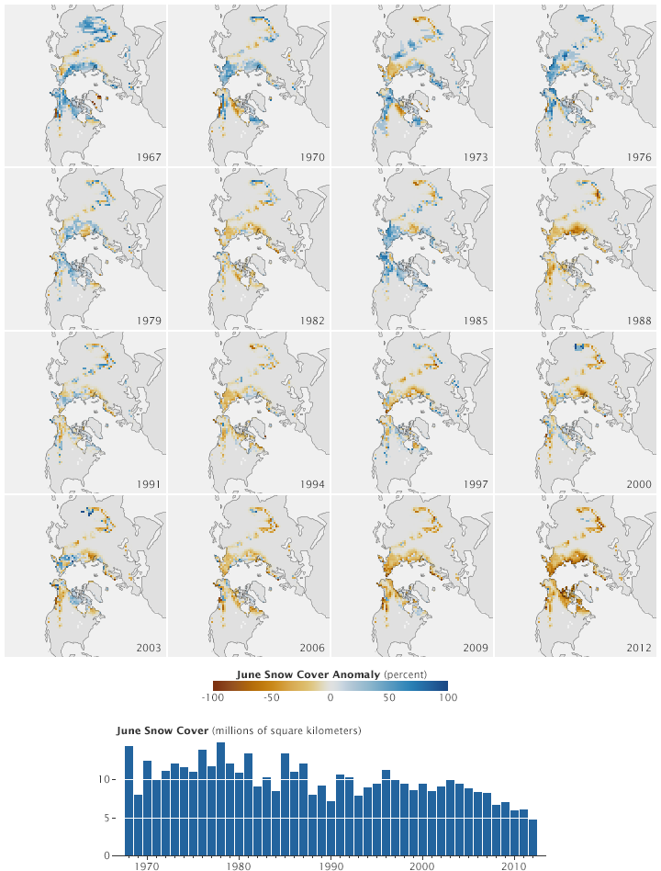
Major disruption is occurring globally in several key areas
The maps on this page show June snow cover extent anomalies for every third year from 1967 through 2012. Each June’s snow cover is compared to the 1971–2000 mean. Above-average extent appears in shades of blue, and below-average extent appears in shades of orange. Toward the beginning of the series, above-average extents predominate. Toward the end of the series, below-average extents predominate.
Credit: NASA Earth Observatory
Global temperature
Ocean temperature
Ice sheet area
Glacier area
Snow Cover
Sea Level
Arctic Sea Ice
Extreme Weather Events
Ocean pH
https://climate.nasa.gov/
Didgeridata | MIT STEAM Camp | 2019
Notes:
https://earthobservatory.nasa.gov/images/80102/snow-cover-extent-declines-in-the-arctic

Slide 9
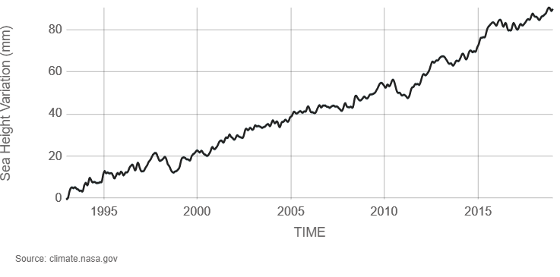
Major disruption is occurring globally in several key areas
Global temperature
Ocean temperature
Ice sheet area
Glacier area
Snow Cover
Sea Level
Arctic Sea Ice
Extreme Weather Events
Satellite Sea Level Observations, 1993-Present Credit: NASA Goddard Space Flight Center
Ocean pH
https://climate.nasa.gov/
Didgeridata | MIT STEAM Camp | 2019

Slide 10
Major disruption is occurring globally in several key areas
Global temperature
Ocean temperature
Ice sheet area
Glacier area
Snow Cover
Sea Level
Arctic Sea Ice
Extreme Weather Events
Every year, sea ice fluctuates through the seasons, growing in the winter and shrinking in the summer. This year, Arctic sea ice reached its annual maximum March 13, 2019. It wasn’t a record low, but it continued a trend of declining sea ice maximums and minimums.. Credit: NASA's Goddard Space Flight Center/ Katy Mersmann
Ocean pH
https://climate.nasa.gov/
Didgeridata | MIT STEAM Camp | 2019
Notes:
https://www.nasa.gov/feature/goddard/2019/arctic-sea-ice-2019-wintertime-extent-is-seventh-lowest

Slide 11
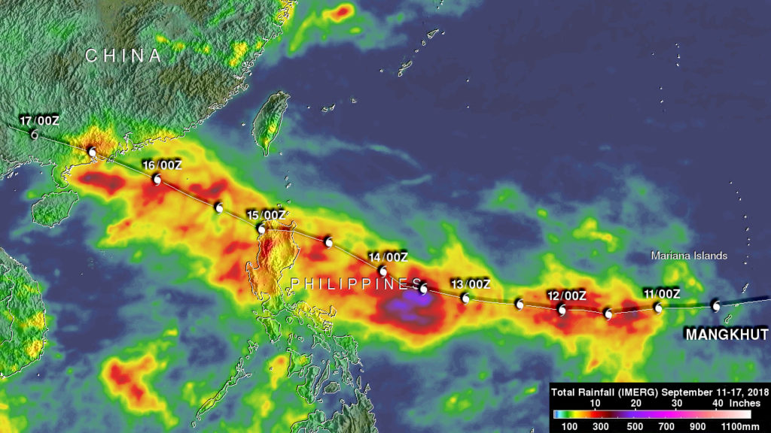
Major disruption is occurring globally in several key areas
Global temperature
Ocean temperature
Ice sheet area
Glacier area
Snow Cover
Sea Level
Arctic Sea Ice
Extreme Weather Events
Ocean pH
The NASA analysis showed IMERG rainfall estimates over the western Pacific Ocean during the period from September 11-17, 2018. Rainfall totals above 300 mm (11.8 inches) were often indicated along Mangkhut’s path. The highest rainfall accumulation estimates of over 700 mm (27.6 inches) were shown by IMERG south of Mangkhut’s track in the Philippine Sea. Credit: NASA/JAXA, Hal Pierce
https://climate.nasa.gov/
Didgeridata | MIT STEAM Camp | 2019
Notes:
https://blogs.nasa.gov/hurricanes/tag/mangkhut-2018/

Slide 12
Major disruption is occurring globally in several key areas
Global temperature
Ocean temperature
Ice sheet area
Glacier area
Snow Cover
Sea Level
Arctic Sea Ice
Extreme Weather Events
Ocean pH
Modeled ocean acidification through 2100 from NOAA's Science On a Sphere.
Credit: NOAA
https://climate.nasa.gov/
Didgeridata | MIT STEAM Camp | 2019
Notes:
https://svs.gsfc.nasa.gov/30794

